Slide 1
BTSA Bootcamp Case Study on ABC Pharma
Group-5
January 23, 2025
Confidential statement
New Delhi +91 124 679 7000

Slide 2






Data Flow
Pivot down performed and history is maintained
Stores the raw data directly
Generation of dashboard
Files on S3
Base Table
Stage Table
Fact/Dimension Table
Reporting Table
Power BI
Data cleaning and duplicate removal

Slide 3
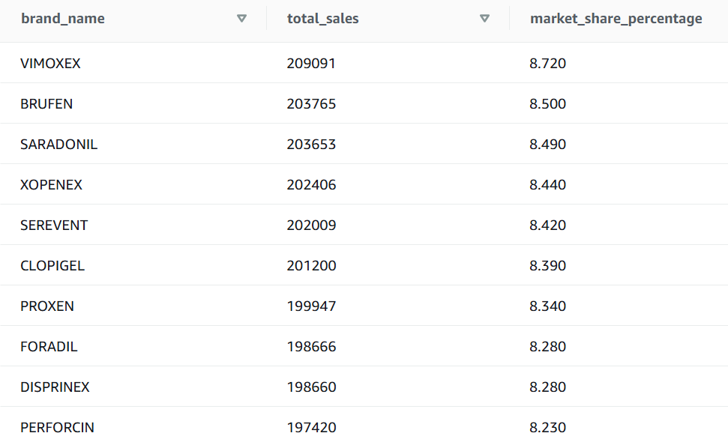
Market Share of the products at brand level
Chart insight:
Table represents brand-wise market performance in terms of total sales and market share.
The brand “VIMOXEX" has the highest market share percentage of 8.7%.

Slide 4
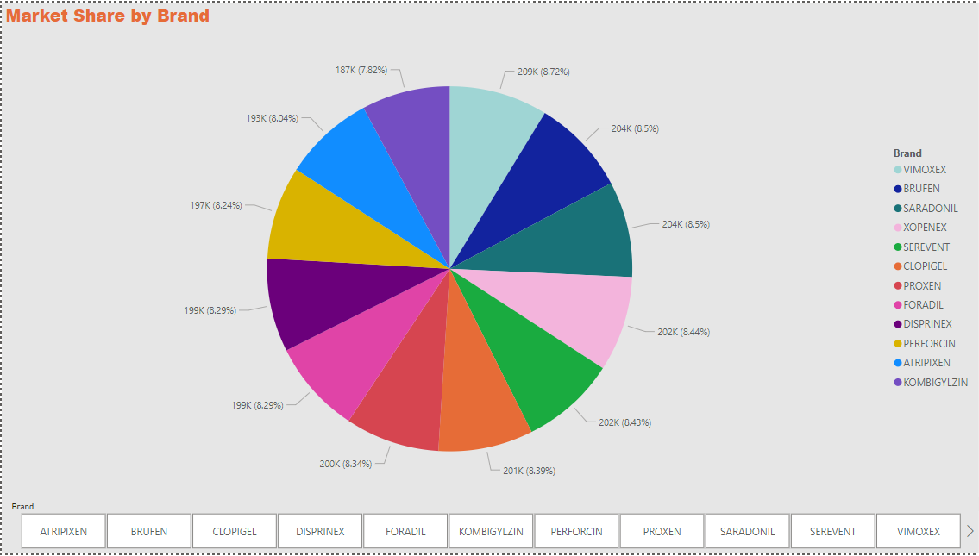
Market Share by brand

Slide 5
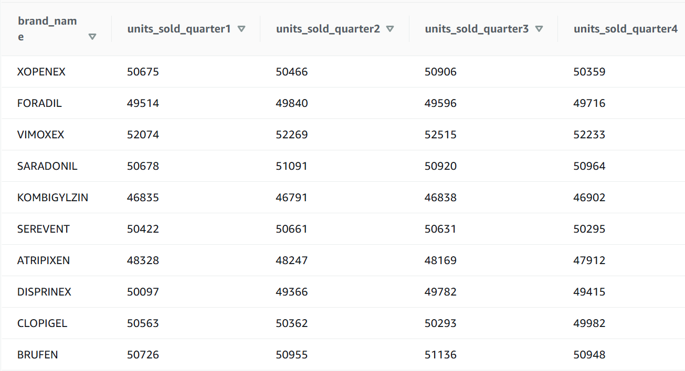
Sales trends of the Products for the last 4 quarters (at Brand level)
Chart insight:
Table tracks quarterly sales performance for different brands.
Brands like CLOPIGEL, PROXEN, KOMBIGYLZIN, XOPENEX show consistent sales across all four quarters with minimal variation.

Slide 6
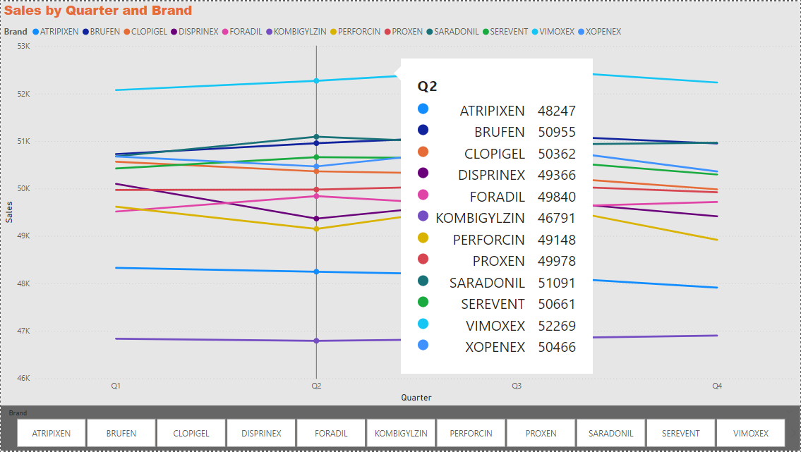
Total Sales by brand

Slide 7
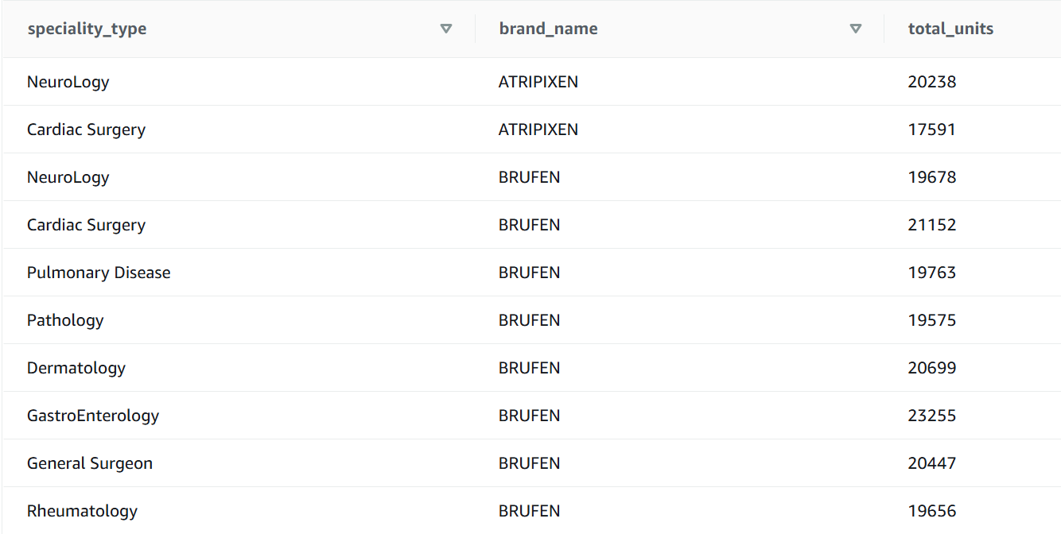
Sales of a Product by specialty type
Chart insight:
Table represents sales data of pharmaceutical products categorized by different medical specializations.

Slide 8
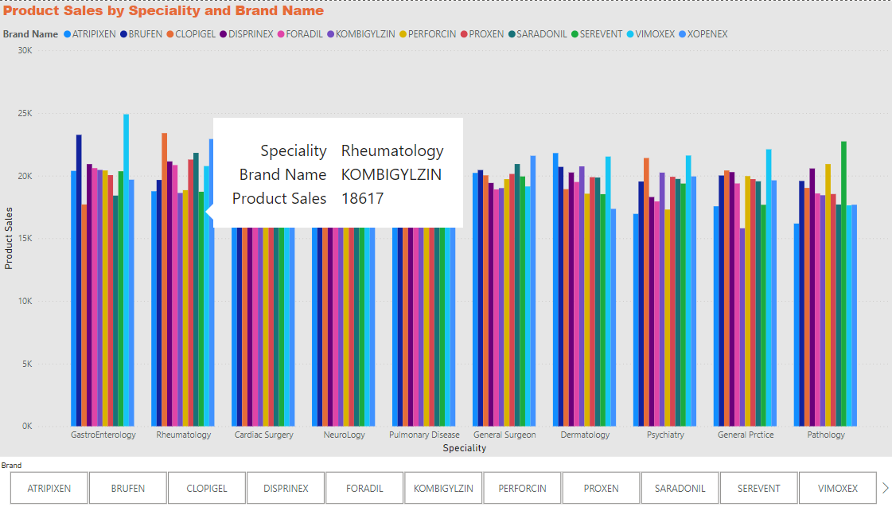
Product Sales by Specialty and Brand

Slide 9
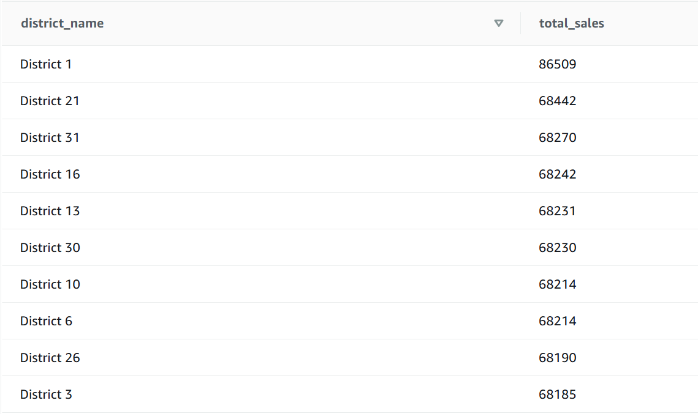
Top 10 districts based on the Sales
Chart insight:
Table represents the top 10 districts with the highest sales.
District 1 leads with the highest total sales of 86,509, significantly outperforming other districts.

Slide 10
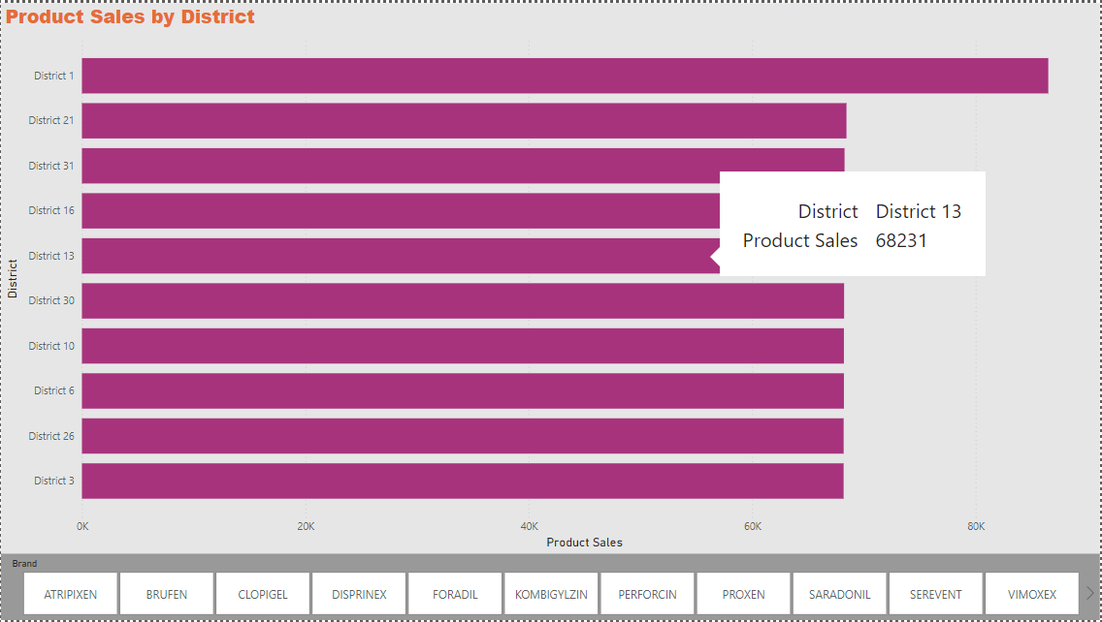
Product Sales by District

Slide 11
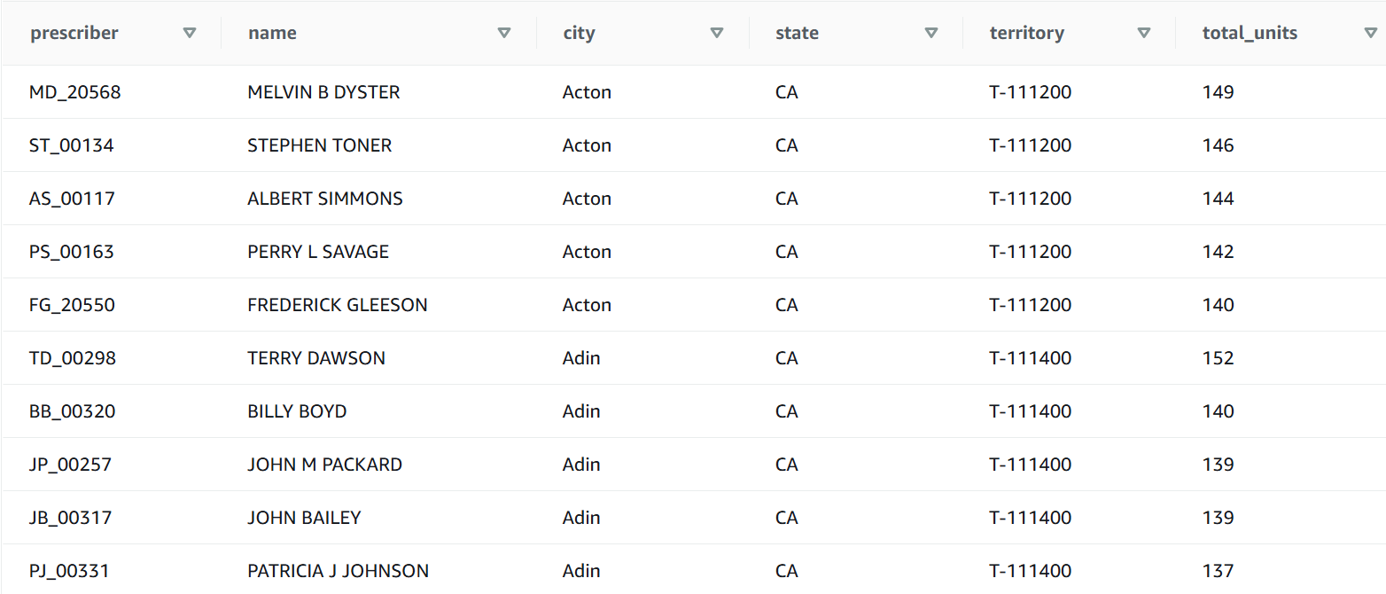
Top 5 best performing physicians in each Territory based on sales
Chart insight:
This table showcases the top 5 prescribers by sales in each territory

Slide 12
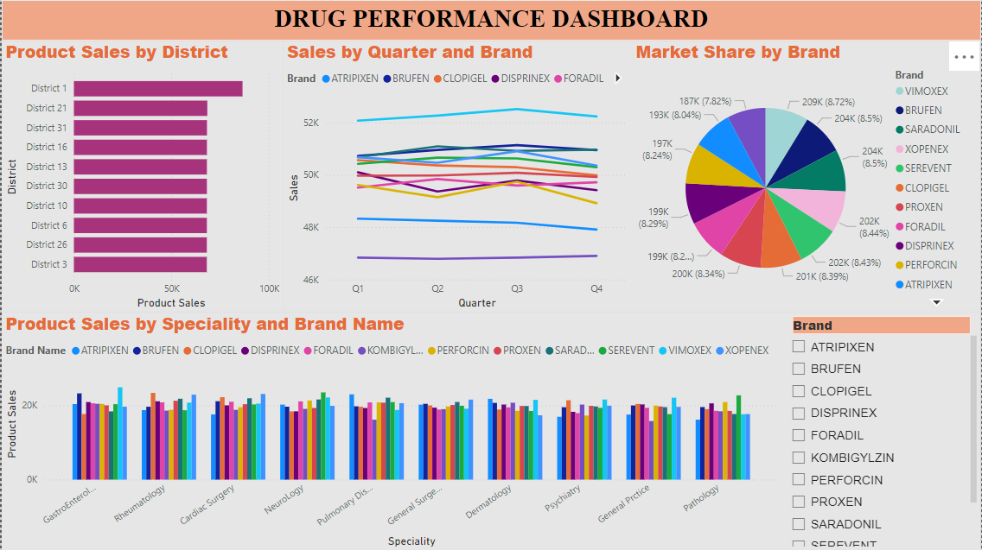
Power BI Dashboard

Slide 13
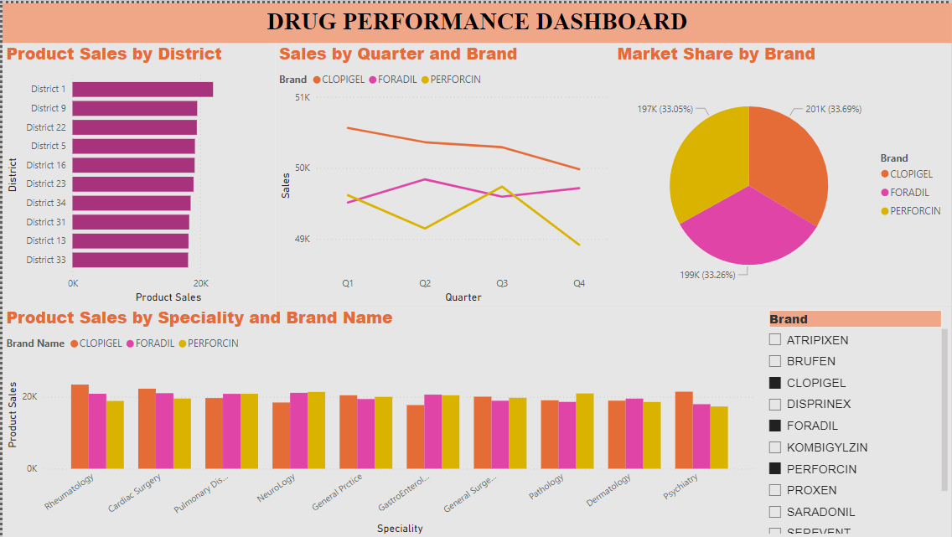
Dashboard showing comparison between different brands

Slide 14
Thank you!

